Slide 1
Title
Higher Dimensional Array Constructions in Steganography
Ron G. van Schyndel, Andrew Z. Tirkel,
Imants D. Svalbe, Thomas E. Hall,
and Charles F. Osborne
Notes:
Original Abstract - This whole page/slide will be deleted in final version
PN arrays can be embedded in the pixel or transform domain (or both) to carry hidden information. Examples include copyright protection, registration reference, or transformations required for the correct interpretation of the image or embedded data.
As the business community seeks to increasingly move its business on-line, there is also a need to address the issue of digital forgery. Digital steganography can also be used here - not only to determine that a forgery has taken place, but also what changes were made.
A current objective of steganography is to provide proof of ownership of an image or an audit trail using an imperceptible watermark.
Because of the ISI properties of PN arrays, multiple simultaneous watermarks can be embedded. Such watermarks can be used for public and private marking of images to provide an audit trail. Alternatively, one can be used for image registration or synchronisation (but with no message capacity) to permit the other, message-bearing watermark to be extracted.
In addition, we have constructed a new type of 2D array - distinct sums array (DS) - to meet the above requirements. Such arrays are constructed by performing a special sequence of cyclic shifts on a seed column with good autocorrelation. Such arrays also have the window property, which is useful for error detection and correction, and good ISI, allowing a greater message capacity.
Significantly, these arrays extend all the properties of one dimensional pseudo-noise sequences to multiple dimensions. Thus its application to Fourier and other orthogonal domains is straightforward.
Colour watermarks can be treated as sets of ordered triples (RGB) or as 8PSK arrays over a non-binary alphabet. These enable embedding and correlative recovery of 3 quasi-orthogonal binary arrays on the different colours. This increases the information capacity and the diversity of watermarks, whilst maintaining the accuracy of the recovery process. This process extends naturally to higher dimensions.
An important feature of SS watermarks is their inherent resilience to cryptographic attack. DS’s can be unfolded and refolded, rendering them robust against any linear cryptographic attack. Complex alphabets offer added security.
In our scheme, watermark recovery is based on correlative pattern recognition with template arrays. In order to ensure correct detection, the embedded array should possess a high figure of merit; approximate balance; the window property; flexibility for image size and shape; and a random appearance.
Our DS array construction allows multiple quasi-orthogonal arrays to be embedded in images with small ISI, and minimal impact on the image.

Slide 2
Overview
Spread Spectrum Communications Techniques
applied to Steganography and Signal Embedding
  Digital Watermarking (Steganography - “Covered Writing”)
    Overview, Uses and Objectives
  The Digital Watermarking Channel Model
    Similarity and Differences to Communications
    Distortion / Attacks, HVS
  A New Array Construction Method
    Higher Dimensional Constructions
    Special considerations for WM applications
Notes:
The use of digital multimedia for profit is pressing for the development of a robust and indelible method of protecting the intellectual property rights of the content creators.
The fields of digital watermarking and steganography have exploded over the last few years as a potentially viable technique as addressing this need.
The use of the spread spectrum technique for digital watermarking was pioneered by Tirkel and Osborne in 1993, when they embedded an invisible message throughout a natural digitised image.
Their initial paper led to the development of increasingly sophisticated algorithms for embedding messages within digital data in multiple dimensions for audio, image, and video. For the most part the common denominator of these methods has been the use of pseudo-noise (PN) sequences in various forms to embed (or scramble) the message.
After a quick overview of the current state of digital watermarking, this lecture will show the construction of arrays suitable for embedding as watermarks. We will also explain the contrary requirements of a good watermark and contrast them to the features of spread-spectrum communications.
We will include a description of the steganographic channel model, as well as a mechanism for mapping the essentially one dimensional streaming of the conventional communication model to higher dimensions.
(Pronunciation: ‘Tirkel’ = TER-kuhl)
(Pronunciation: ‘Steganograpy’ = STEG-uh-NO-graphy)
(Pronunciation: ‘Steganographic’ = STEG-uh-no-GRAPH-ic)

Slide 3
What is a Digital Watermark (WM) ?
Information Hiding (Steganography)
  Message is embedded imperceptibly into host multimedia
  Message ‘hides’ in background noise
    Data must have an inherent noise margin → digitised data (usually)
Digital Watermarking
  Data Hiding where information is embedded in a robust manner specifically to prevent removal or erasure
When to use Spread Spectrum Signalling as WM?
  Principally used for digitised media, where the host can tolerate distortions
  Redundant signalling → robust against distortions
  Locally adaptable → Independent amplitude modulation is possible
Notes:
Digital steganography can be defined as the subtle perturbation of elements of digital multimedia data.
In most cases, the media is composed of digitised samples from the real world. This means there is a base level of quantisation noise in the medium within which the message can hide.
For information hiding, the main criterion is that the information not be perceptually detectable, but still recoverable by authorised people.
An ideal watermark, on the other hand, will be embedded such that, in addition to undetectability as in information hiding, it is also indelible.
So a watermarked image, for example, should be indistiguishable from an unwatermarked version of the same image, but no matter what is done to the image - provided it can still be passed off as an orignal - it should be impossible to remove the watermark. Such a watermark is said to be robust.
The key concept to watermarking is that a structured probe signal has been embedded in the data which is recoverable even after data manipulation.
This is where the spread spectrum techniques come into play.
Its features of redundant signalling local adaptibility and its resistance to many types of distortion, leads it to be the preferred vehicle for many commercial watermarking technologies in use today.
For brevity, in the remainder of this lecture, the terms watermarking and information hiding will be used interchangably. The ultimate application will usually make it obvious which one of these is intended.

Slide 4
Where to find Digital Watermarks ?
Suggested areas where Watermarking can be used
  Audio, images, video, Formatted text (PS files),
  3D Object coordinates, MIDI music,
  surface texture (eg of engine castings),
  Acq/Nacq modulation and other protocol perturbations,
  choice of equivalent gates in FPGA’s,
  equivalent reorderings of program code,
  stereoscopic / stereophonic imagery,
  RF emission modulation, video sync perturbations, …
Notes:
As shown in the list, as well as the forms usually associated with digital multimedia - audio, static images and video - there are many other areas where watermarking has been used or suggested.
For formatted text, for example, the precise to-the-dot positioning of the letters on a page can be perturbed by a watermark
A more unusual suggestion has been the embedding of an encoded message within the surface of rnginr castings. One can imagine how difficult it is to file down an engine number if it is present everywhere on the engine!
The list also includes hiding information within procedures and protocols. A fairly old signalling method is to effectively use the positive and negative acknowledge signal as a morse code.
Since there are multiple ways of implementing equivalent gates on FPGA’s, the ultimate choice of gates may itself be a code
Even playing SOS on certain device-enable lines in a PC can modulate the RF emissions of the PC which is detectable by an ordinary radio !
A public watermark can be created by making a pair of identical images, then perturbing them positionally such that when viewed stereoscopically, a message appears to ‘float’ out of the image. One of these images is released to the public, the other is kept privately for authentication purposes. This form is easily defated however, as will become clear later in the lecture.

Slide 5
Digital Watermark - Definitions
Attributes and Terminology:
  Robust: Resists all attempts (ideally) to remove it without damaging ‘host’
  Fragile: Will show if an image is at all damaged, and where it was changed
  Private: Requires original.
  Blind: No original required
  Domain: Transform Domain where watermark is applied (DFT,DCT,DWT)
  Invertible: Watermark can be removed (ie. no data loss on embedding)
  Public/Private: Public WM detection process is different to private embedding or recovery for security - cf Public-Key Cryptography
Notes:
Here is some of the terminology used in the context of digital watermarking. As stated previously, an ideal robust watermark is one that resists all distortions and other attempts to remove it.
A fragile watermark, on the other hand, can acts as a checksum, so that any change will render it unreadable. This would apply to authentication.
Many semi-fragile image watermark are still recoverable after change, but will reveal the regions of an image that were changed. This might be useful, for example, in news reel photographs - indeed, digital cameras now exist which embed such a watermark automatically.
Many of the watermarking algorithms initial published required that the original data be available to the detector. It would typically be subtracted from the watermarked data to reveal the watermark itself. These are referred to as private watermarks. Watermark detecctors that do not need the original have been called blind detectors.
Here the definitions can get a bit blurry, since the terms public and private watermark detectors have also been used to refer to models analogous to public key encryption systems. In this situation, a publically accessible watermark detector uses a method quite different to a private detector, so that an attacker cannot infer the watermark structure by, for example, disassembling the public detector. Making such a watermark undetectable using the public detector, does not necessarilly make it undetectable to the private detector, which only the originator of the watermark possesses.
An invertible watermark is one where the embedding process can be reversed to yied the original data exactly. For the same reason as with pblic watermarks, security, this is not a desirable feature, and most recent watermark are not invertible.

Slide 6
Digital Watermarking/Data Hiding - Uses
Robust/Fragile
Security and Privacy Example DW/DH
  Copyright Enforcement (+++) Multimedia productions DW R
  Data Authentication (++) Security monitoring DH F
  Tamper-Proofing Signature validation DH R
  Covert Communications Military DH R
Information Embedding
  Captioning / Labelling Settings on patient XRAY DH R
  Image Registration Lat/long on satellite pictures DH F
  Audit / ‘Time-Stamping’ Air-time broadcast verification DW R
  Object / Context Info Content-based archiving DH F
Notes:
In contrast to the speculations of the last slide, here are some applications where watermarking has already been used and commercially available for some years.
Also listed are whether these applications require a digital watermark, or just data hiding - where the requirement to prevent removal of the watermark is not so crucial.
A message embedding technique is considered robust is it resists all attempts to remove it from the host, but it is considered fragile if any change to the host data causes change to the watermark and is thus detectable.

Slide 7
The Generic Watermarking Channel
C
Channel
D
XFM
Embed
XFM⁻¹
+
NOISE
C_{w}
D_{w}
W
S
Attack
M
K₁
WM
Visible?
Detect / Extract
D_{n}
S⁻¹
XFM
M_{e}
W_{e}
C_{we}
K₂
XFM: Invertible Transform
S: ‘Spreading’ function
Notes
Conforms to the “Channel Model” except for ‘WM Visible?’ criterion.
Multimedia data D (‘host’) is transformed to a domain C suitable for the watermark.
Message M is spread to a sequence using key K₁ and embedded within C.
For simplicity, noise model is AWGN
The more general model, ‘Attack’, can be any linear or nonlinear modification to the image.
As a minimum, D_{n} = Quant(D_{w})
Notes:
So lets look at the generic watermarking channel model.
As you can see, this channel model resembles the traditional communi-cations channel model is most respects.
The principal difference is the visibility criterion. This can be roughly considered analogous to a power limitation requirement, but the human visual system is a much more ‘fussy animal’ when it comes to watermark detection.
In the above scenario, the multimedia data, D which is often referred to as the host data, is transformed into some other invertible domain. Typically this is the frequency domain, so the transform is a Fourier or discrete cosine transform.
The message is also transformed or encoded. In the case of spread-spectrum signalling, the message is encoded by a spreading function.
Some examples of the embedding process will be shown in the next slide.
The channel noise was modelled by early models of watermarking as additive white Gaussian, but more recent efforts use a more general non-linear distortion or attack noise model. This noise modelling is one of the active areas of research in watermarking, but its mitigation is very dependent on the features of a particular watermarking algorithm and is beyond the scope of this lecture.
Like the traditional channel model, the detection or extraction process typically involves matched filtering or a correlation.
Notice how the spreading and de-spreading functions use a key, and that they need not be the same for embedding and recovery. This provides a level of security. This way, even if the recipient can extract the watermark using key K2, he may still not be able to use this to watermark new images. Such a watermark is referred to as having a non-symmetric key.
(Pronunciation: ‘Fourier’ = FOOR-ee-ay)
(Pronunciation: ‘Gaussian’ = GOW-shun)

Slide 8
Digital Watermark - Examples
Linear
  α Scaled WM added to Magnitude of Frequency components
Non-Linear
  WM, scaled by colour saturation, is added to Hue angle
  Angle addition → multiplicative embedding
I_{gray}
R
I’_{gray}
+
DFT
φ
DFT⁻¹
M
W
S
×
α
I_{rgb}
H
⊕
RGB
to HSV
HSV
to
RGB
I’_{rgb}
S
V
M
W
S
×
= Scaling
= Addition modulo 2π
×
⊕
Notes:
Here are two simple embedding functions.
In the first case, the multimedia data is a monochrome image, which is transformed to the frequency domain. The magnitude of the frequency components are perturbed by the watermark, scaled by a constant, alpha, which might be determined manually, based on visibility.
This form has been referred to as first generation watermarking, because the watermark is not adjusted to the image. In fact the detector would simply treat the image as un-correlated noise.
These watermarks are relatively easy for an attacker to remove.
In the second case, a colour image is transformed to the Hue-Saturation-Value colour model. In this model, the intrinsic colour of the image pixels, the hue, are related to angles on a ‘colour wheel’, with red at zero dgrees, green at 120 degrees and blue at 240 degrees.
Since hue is an angle, an additive perturbation is equivalent to a multiplicative embedding.
In addition, the image saturation scales the watermark intensity, so the watermark is dependent on image characteristics. This is an example of a second generation watermarking process, where the watermark is adjusted by image characteristics.
In this particular case, the value or brightness could just as easily have been used to scale the watermark. Both relate to the visibility of the watermark.
Because we are, in effect modulating the hue angle, we could employ a phase or frequency shift keying modulation here, but in this lecture we will concentrate on spread spectrum modulation.
(Pronunciation: ‘multiplicative’ = mul-ti-PLI-kha-tif)

Slide 9
Channel Equalisation
D
WM Embedding
D_{w}
M
Parameter
Adjustment
Distortion / Attack Modelling
K₁
WM
Visible?
K₂
WM Detection
WM Channel is band-limited.
WM Detector is employed in embedding process to maximise detectability as well as minimise visibility.
Notes:
More recent watermarking algorithms have involved a degree of pre-distortion.
In the model shown, the watermark detector is used to adjust the embedding parameters in order to maximise the detection of the watermark for this particular host data.
This means that for different host data, the parameters may be quite different, even if the embedded watermark was identical.
The host data, watermark and detector are all available to the embedder, so an optimal equalisation process is possible.
This is the cutting edge of research in watermarking at the moment and is an example of third generation watermarking, where optimality of detection is considered as well as visibility.

Slide 10
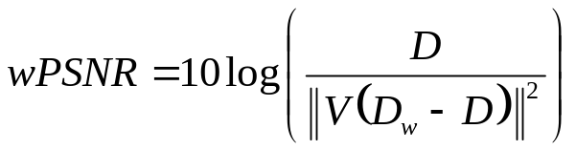
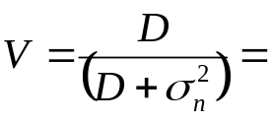
Digital Watermark - Objectives
There are 3 contrary requirements determining watermark effectiveness
Visibility
  Measured in HVS terms, hence PSNR or MSE are not useful measures
  No accepted ‘visibility; standard. JPEG/MPEG models most often cited
  Weighted PSNR to account for local HVS sensitivity (Pun),
Capacity
  Measured as bits of embedded text (I.e. Channel Capacity)
Robustness
  For message: Measured as bit error rate or probability of false detection
  For image: Measured as distortion penalty
‘Noise visibility Function’
Notes:
In general, an optimal watermark can be found is by maximising one of the three parameters shown: visibility, capacity and robustness - usually at the expense of the other two.
One suggestion for a visibility measure is a weighted peak signal-to-noise-ratio, where the sensitiviy of the measure depends on the local variance. But this is one of many such measures suggested over the years.
There is, as yet, no commonly accepted standard for human visual or auditory response. The models most often cited are those models that shaped the definition of the JPEG and MPEG visual and audio standards.

Slide 11
Digital Watermark - Observations
General attributes of an ideal watermark
  WM must be perceptually undetectable
  WM must not be invertible, so that it cannot be removed completely
    Non-invertible WM’s usually involve some form of quantisation (info loss)
  WM must have power spectral density resembling that of Image (Su)
    Any attack maximises the distortion penalty
    If Φ_{WM} == K Φ_{I} , then WM cannot be removed
  WM embedded in frequency/scale domain is generally more robust
    Freq: DFT/DCT/Walsh/Hadamard, Scale: Wavelet
    Rotation/Scale/Translation invariant watermarks exist (O’Ruanaidh/Pun)
Desirable
  High Message Capacity / Low Power / Fast and easy to generate
Notes:
So, in summary, here are some observations that are pretty much standard requirements of a digital watermark today.
A watermark is generally imperceptible, but visible digital watermarks do exist - a cable TV channel logo probably being the most often seen.
If a watermark is invertible, then it can be removed by an attacker. In most cases this is undesirable and so watermark invertibility is most often prevented by involving a quantisation process in the embedding.
In order to ensure that the watermark cannot be removed, we place the watermark using the same frequency components as the image itself. That way, trying to remove the watermark causes maximal damage to the image. This damage is measured as a distortion penalty paid to remove the watermark.
If a watermark is not embedded in a transform domain, the biggest danger from attackers lies in the desynchronisation of the spread spectrum arrays used to encode the watermark.
This could be done by something as simple as an image rotation.
One way to fight this kind of attack is to embed in a transform domain which is invariant to some of these image transformations.
O’Ruanaidh, for example created a watermark procedure which is invariant to image rotation, scale and translation.
Another way is to explicitly resynchronise the image, and this is where the use of 2D arrays can assist.
(Pronunciation: ‘O’Ruanaidh’ = o-ROO-nee)

Slide 12
Digital Watermarking - Distortion / Attacks
Kinds of Distortion
  1D Audio: resampling, reordering, rescaling, truncation, (non)linear filtering, DA/AD, requantisation, apply noise, addition of echos
  2D Image: non-uniform geometric warping, rotation, intensity / histogram modification, mosaicing
  3D Video: Frame: reordering, deletion, duplication, average, interpolation, compression, jitter
  Lossy Compression: Reducing redundancy using perceptual rules may distort the watermark
Kinds of Attack
  Collusion
    estimate watermark using many copies of the same image, each differently watermarked
    frame averaging
  Confusion
    make it impossible to detect watermark (lost synchronisation)
  Deadlock
    superimpose counterfeit watermark with equal detection probability (which WM was first ?)
Notes:
To end this overview of digital watermarking, we present a reasonably comprehensive list of distortions which any self-respecting watermark should be able to resist to some degree.
As you can imagine, given the list on the left, this is no mean feat.
Unfortunately, in addition to these, it must also be resistant to deliberate attack, only some of which are shown here on the right.
It is competing against these odds, that make the development of the ultimate watermark so interesting.

Slide 13
The Spreading Function, S
Constructing 2D Arrays from 1D Sequences
(McWilliams & Sloane, Green, Everett, Lüke)
  Product Array
  Folding / Unfolding
  DSP construction
  Others
  Kronecker perfect arrays
  tiling m-arrays
  twin-prime quasi m-arrays
M
1D
2D
W
K₁
Key K₁ may determine construction method and parameters for the WM sequence used.
Message M is embedded in sequence, then these are all merged to an array.
Notes:
For the second part of the talk, we will concentrate on the development of arrays that can be used as a watermark to embed a message.
These array constructions can and have also been used in more conventional signalling.
We will essentially look at 2 commonly used 2-dimensional constructions from 1-dimensional sequences - product arrays and array folding, and then we will introduce a third construction method.
The sequence and array parameters can be formed from the key K1, which can then be used to encode the message.

Slide 14
Candidate Sequences
Binary
  M-sequence GMW
  Gold Kasami
  No Legendre
  Twin Primes Hall
  Kerdock and other codes
  Best Auto-Correlation Mag = (p-1,-1)
    (Legendre)
  Best Cross-Correlation Mag = (0,√p)
    (Legendre)
Complex
  M-sequence Legendre
  DSP, FZC and other Chirp Seq
  Opperman & Vucetic (Periodic)
  CAP
  General Orthogonal Sequence families where the sequence alphabet and the cross-correlation between members is not controlled
  Best Auto-Correlation Mag = (p,0)
    (DSP,FZC,CAP)
  Best Cross-Correlation Mag = (√p,√p)
    (FZC,DSP)
Notes:
Here is a list of eligible sequences for the 2-D constructions.
Most of these sequences originate from CDMA communications where inter-symbol interference (or the minimisation of cross-correlation between different members of a set of sequences) plays a significant role.
For digital watermarking, there are applications where good cross-correlation is specifically not wanted and the ideal behaviour should be pathological.
For example, trying to embed a second authentication watermark on an already watermarked image should ideally result in obvious damage to the image - perhaps as a highly visible moire pattern.
The binary sequences, while optimal for modulation in a mean-squared sense, suffer from the fact that there is always some inter-symbol interference. This is because sequences lengths are almost always odd, and so symbols don’t add to zero. The correlations are thus never perfect.
The complex watermarks, on the other hand have greater message capacity, but even though the correlations can be perfect, the inter-symbol distance is reduced, so these methods are often less robust.
(Pronunciation: ‘moire’ = MWAH-ray)

Slide 15
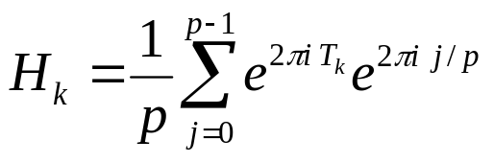
PN Sequence Constructions
Cyclic All-Pass (CAP) Sequence (Ramkumar)
  1. Generate S_{p} = random ∈ {0..1}, length p, seed K₁
  2. Form sequence:
  T = {0, S₁, S₂, …, S_{p}, 0,-S_{p},-S_{p-1}, … ,-S₁}, p = even integer
  3. Take the Fourier Transform:
|R _{HH}| = (p,0), R_{GH} = unconstrained (not important for WM)
Large number of sequences possible, determined by a random seed, K₁
Notes:
From the list of complex sequences in the previous slide, we will look at two varieties in a little more depth.
The chirp-like cyclic all-pass sequence is an easy-to-generate instance of a general class of ortho-normal sequences which possess the ideal auto-correlation property needed for signal extraction.
Like most sequences in this class, the cross-correlation between different sequences is unconstrained, so it is difficult to model the probability of false detection.
Note, however that the correlational properties inherent in the higher dimensional constructions can be used to overcome this limitation.

Slide 16
More PN Sequence Constructions
Distinct-Sums-Property (DSP) Sequence (Hall/Tirkel)
  1. Generate a roots of unity ramp:
  S(k) = exp(2πι k/p), k = 0..p-1, p = prime
  2. Shuffle S to form the sequence T using parameter m ∈ {1,2, …, p-1}:
|R_{TT}| = (p,0), |R_{TU}| = (√p,√p)
p-1 different sequences possible. Because of ramp, all angle equally represented.
Kronecker product of DSP/CAP/FZC seq, length p, with another seq, length q, also gives good auto-correlation but NOT good cross-correlation with a different combination, but the same length, pq, ---> ISI not good, sufficient for watermarking.
  |R_{TT}|: (peak: pq, off-peak:0 for all but q values on both sides of peak
  Allows synchronisation on multiple scales.
Notes:
Hall and Tirkel have recently introduced a new chirp-like sequence which also has ideal auto- and cross-correlation properties.
For a complex sequence of length p, p being a prime number, there are a set of p minus 1 possible sequences in the family. Each of these sequences has a perfect auto-correlation and ideal cross-correlation other members in the set.
What’s more, a Kronecker product of this with other chirp-like sequences also yields very good correlation properties. A combination of these effectively allows a very large family of sequences to be developed, so the message capacity has the potential be large.
For direct-sequence insertion, these product forms allow multiple scales to be examined at once. For watermarking, multi-scale embedding is better achieved by applying the watermark in the Wavelet transform domain.
As with the cyclic all-pass sequences however, modelling the probability of false detection can be difficult, and is being studied presently.
(Pronunciation: ‘Kronecker’ = KRON-ek-uhr)

Slide 17
Product Arrays
A_{ij} = P_{i} x Q_{j}
  If P,Q are complex unit vectors, then this becomes angle addition.
  Also applies to higher dimensional products
  If R_{PP} = (a, b, c) and R_{QQ} = (d, 0)
  the R_{AA} = (ad, bd, cd, 0)
  Perfect Array results if FZC sequences are used.
Product-Array
Auto-Correlation (mag)
M-, L- Seq
FZC Seq
Notes:
Tuesday January 11, 1999
Algebraic Construction of a New Class of Quasi-Orthogonal Arrays in Steganography
The simplest two dimensional construction is just a vector product of a row and column vector to produce a P by Q matrix.
The shape of the auto-correlation is shown below.
This process can, of course, be repeated to any higher dimensions desired.

Slide 18
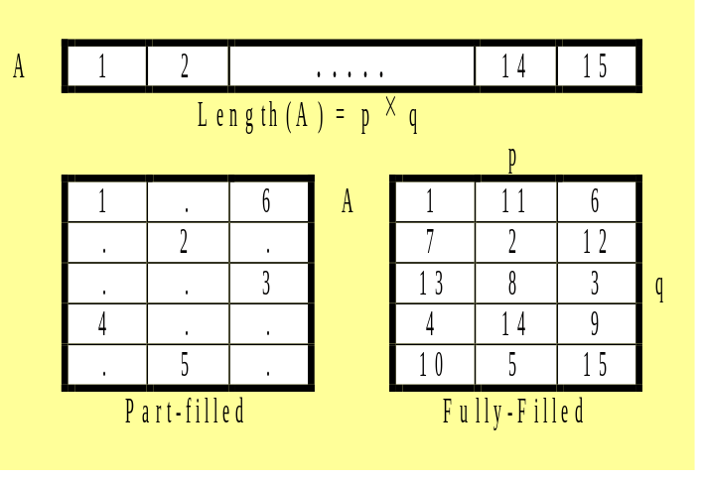
Folding Arrays
Sequence A_{i} is laid out along major diagonal of array pq
  First used for watermarking by Swanson & Tewfik
  p and q must be co-prime for complete coverage.
  Sequence length, N, must be composite (pq=N)
  Auto-correlation
    (Peak: ~pq, else: -1)
Auto-correlation (mag)
Notes:
Tuesday January 11, 1999
Algebraic Construction of a New Class of Quasi-Orthogonal Arrays in Steganography
Sequence folding has been used in image watermarking almost from the beginning as a means of utilising the properties of a 1 dimensional M-sequence over local image blocks.
This method has been used in communication and coded-aperture imaging for a long time.

Slide 19
Distinct Sum Arrays - Definition
A sequence S_{p} = {S₁,S₂, … ,S_{p}}, p = prime, has the distinct sum property if:
  S₁+S₂, S₂+S₃, … , S_{p-1}+S_{p}, S_{p}+S₁ are all distinct, and also
  S₁+S₂+S₃, … , S_{p-1}+S_{p}+S₁, S_{p}+S₁+S₂, and so on for k = 4...p-2 consecutive sums
To make an array, the seed sequence is placed in each row, phase shifted progressively by a value m × (row number-1) relative to the previous row, where m=1..p-1. The columns then possess the DSP property.
  Example: For the 5-element sequence below relative phase offsets
  are: m × (0,1,2,3), for each of m = 1..4
Readily extendable to higher dimensions
Notes:
Tuesday January 11, 1999
Algebraic Construction of a New Class of Quasi-Orthogonal Arrays in Steganography
This new construction method, related to the DSP sequence generation outlined before, uses the first principles of difference-sets to obtain the ideal correlation properties as an intrinsic part of the construction method, instead of only relying on the properties of the component sequence.
One can thus use any random sequence in this construction method and obtain an ideal correlation in the direction in which the construction is applied, which in this case is vertical. The only requirement is that the sequence is balanced (that is, it sums to zero) and be of prime length.

Slide 20
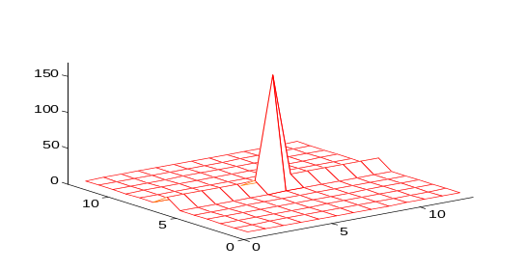
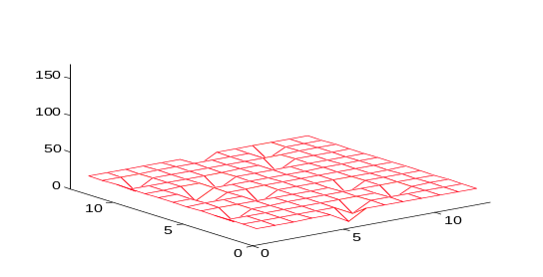
Distinct Sum Arrays - Features
Adjustable parameter, m, yields p-1 different 2D arrays. This allows multiple superimposed WM, each separately recoverable.
For a seed seq with two-valued auto:
  Auto-correlation is:
    Peak: Order(p²),
    Ridge: Order(p),
    Background: Order(1)
  Cross-correlation between
  different ‘m’ is constrained to:
    Maximum: Order(p),
    Minimum: Order(1)
Auto-correlation
(Magnitude for M-Sequence, Legendre)
Cross-correlation between different ‘m’
(Magnitude for M-Sequence, Legendre)
Notes:
Tuesday January 11, 1999
Algebraic Construction of a New Class of Quasi-Orthogonal Arrays in Steganography
In practise however, the noise tolerance of this construction is usually insufficient in itself, and the performance is dramatically Improved if the constituent sequence also has has ideal or near-ideal correlation property.
The particular benefit of this method is the availability of a free parameter ‘m’ which can be used for message embedding.
The cross-correlation of DSA’s with different ‘m’ values is also near perfect.

Slide 21
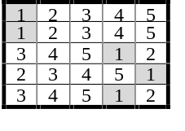
Distinct Sum Arrays - More Features
Strong Window Property
    An array that can be partitioned into all its constituent windows of equal size, such that each window appears exactly once.
    Only Perfect Maps possess this property
    Location of any window within an image identifies its position unambiguously - perfect for image registration
Weak / Split Window Property
    Don’t need to contain all possible windows of a given size
    Rows/column need not be adjacent, but spacing must be uniform
Array Span
    Where arrays can be constructed using recursion to a sub-array, the minimum size of such a sub-array is called the linear/non-linear span of the array.
    DSA’s have a large linear span
Notes:
The DSA construction also possesses the weak window property which can be employed in circumstances where automatic watermark detection may not work - for example, where parts of an image are destroyed and you must use the remaining part to establish the watermark presence.
In addition, distinct sum arrays have a large linear span and, combining this method with array folding present significant cryptographic security when this is needed.

Slide 22
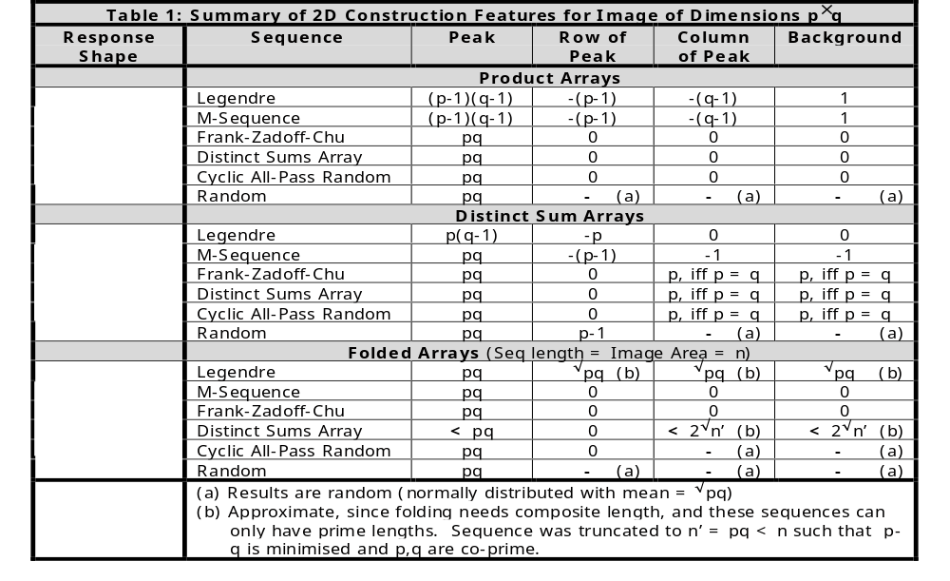
Comparison of 2D Constructions
Notes:
This table, also included in the lecture notes presents a summary of the useful combination of some of the more popular sequences constructed as arrays.
Note how the chirp sequences all respond in a similar manner to the constructions.
Also note that the Legendre sequence has a perfect response to the DSA construction.
(Pronunciation: ‘Legendre’ = Luh-SHOHN-duhruh)

Slide 23
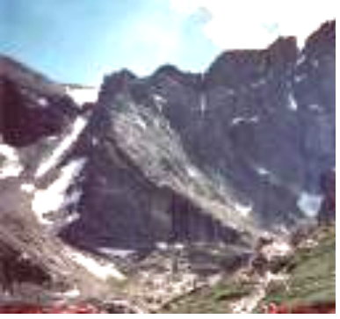
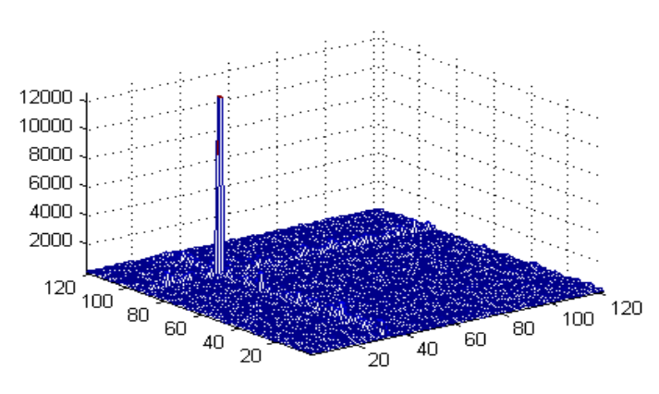
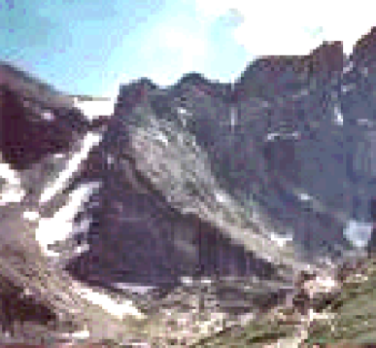
An Example
D
128x128 JPEG
D_{w}
WM Detection using Correlation
NB. WM was applied with enough power to make it just visible (the sky shows the ‘Mach band’ effect). In this instance, the peak would still have been detectable at 1/40th this power level. HVS filtering was not used.
Notes:
Finally, some example images.
This is an example of how the human visual response varies over an image. The watermark intensity is uniform over the image, but it is only clearly visible in the sky part of the lower picture. This watermark was deliberately enhanced to reveal its presence.
The size of the correlation peak leaves no doubt as to the presence of the watermark, but this peak would still be detectable if the power of the watermark were reduced by a factor of 40.

Slide 24
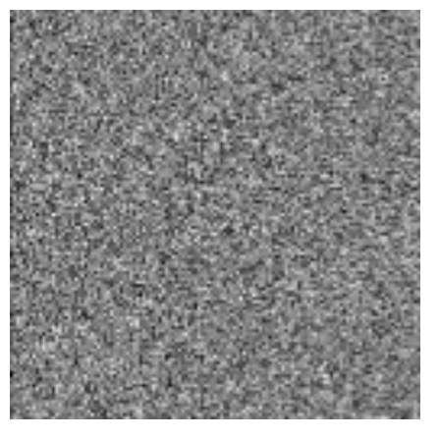
Multiple Watermark Embedding
A DSP construction was applied to a 127 element binary Legendre sequence (with values +1,-1) to yield a 127x127 2D array.
Four such arrays were added together (upper), each with its own 2D phase shift and unique value of m = {1,2,3,4}.
4 Binary Watermarks
Notes:
In this instance, 4 binary bipolar watermarks were added together to produce the watermark shown.
This watermark has values of -3, -1, 1 and 3

Slide 25
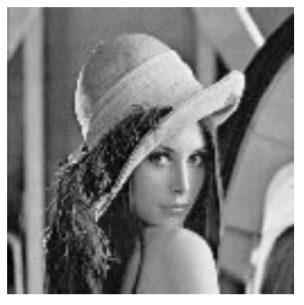

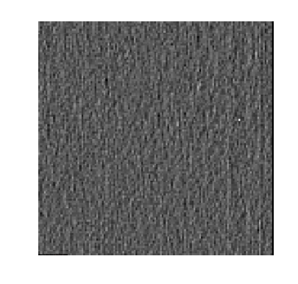
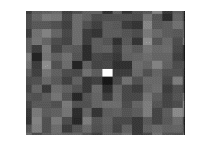
‘Lena’ with 4 watermarks (m = {1,2,3,4})
Original
127x127x8 bit
127x127 binary watermarks added in spatial domain for 4 different
m-values
Filtered Correlation Output showing the location of 1 peak for m = 1
Notes:
Tuesday January 11, 1999
Algebraic Construction of a New Class of Quasi-Orthogonal Arrays in Steganography
These 4 watermarks are then added directly to the image with clipping where required. To improve recovery, we perform a local 3 by 3 Laplacian operation to the output of the watermark correlation. The peak location can be used to encode a message.
A 127 by 127 image was chosen as the smallest practical limit for image capacity. The 16,129 pixels that make up this image can thus store 7 bits by 7 bits by 2 bits, or 16 bits of information for this very simple watermark implementation. The storage capacity quadruples for every doubling of image side length.
As you can see, the peak is quite ‘clean’.
What if we now used the same ‘m’ value in 4 different watermarks?
(Pronunciation: ‘Laplacian’ = La-PLAA-shun)

Slide 26

‘Lena’ with 4 watermarks (m = 1, 4x)
Original
127x127x8 bit
127x127 binary watermarks added in spatial domain for 4x the same
m-value
Filtered Correlation Output showing the location of 4 peaks for m = 1
Notes:
Tuesday January 11, 1999
Algebraic Construction of a New Class of Quasi-Orthogonal Arrays in Steganography
In this case, we generated another sum of 4 watermarks, but these had the same ‘m’ value, so a cross-correlation reveals them all.
Now the peak locations can be used as a registration mask.
In these images, we concentrated on showing the effects of using the 2D masks. A commercial grade watermark would include a number of measures to improve robustness, but these are too involved to show in these lectures. The references included discuss some of these measures more fully.

Slide 27
Conclusion
  Overview of the Data Hiding / Digital Watermarking Channel Model
    Similarity and Differences to Communications
    Distortion / Attacks
  Array Construction Methods
    Higher Dimensional Constructions from 1D Sequences
    Special considerations for WM applications
    Good Auto-correlation required for signal (WM) extraction
    Good Cross-correlation between different members of the one family of constructions is needed, if multiple WM is desired, and the probability of false detection needs to be constrained.
Notes:
So, in summary, we have looked at the the watermarking channel model and in terms of similarities and differences with the communication channel model.
We’ve also looked at the many ways in which watermarks can be attacked.
Finally, we looked at how higher dimensional arrays can be constructed from 1D sequences, while maintaining their correlational properties.

